Slide 1
MODULE 2
THE HISTORIAN AT WORK
Searching For Historical Sources
All the material which has a direct bearing or can be any assistance in
constructing the history of a particular period is called as historical facts or sources.
The surviving evidences of the past is considered as the sources of historical writing or reconstruction
It may be a document, a building ,a piece of art or an object
Sources become a historical evidence only when they are interpreted by the historian to make a sense of the past
The historical sources can be of two types, i.e. Primary and Secondary Sources.
A primary source is the evidence of an eye witness or mechanical device which was present at the time of the occurrence of an event.
It is the work of the historian to convert the scattered difficult primary evidences into coherent, intelligible secondary sources.

Slide 2
The secondary source is the evidence of someone who was not present at the time of occurrence of the event e.g., books written by historians.
The secondary source is also of great historical importance to the historians although secondary source is itself dependent on primary sources.
A primary source may contain secondary information e.g., news papers are usually considered primary sources but the information provided by news paper is not all based on primary sources.
Such as certain incidents reported by the paper may be such which the correspondent saw or in he actually took part while certain offer information may be based on official information or sources considered reliable

Slide 3
Define Historical Fact
A historical fact is a fact about the past.
It answers the very basic question, "What happened?"
Yet beyond merely listing the events in chronological order, historians try to discover why events happened, what circumstances contributed to their cause, what subsequent effects they had, and how they were interpreted.
In an effort to get at what really happened, historians compare stories from a wide variety of sources
Accounts are compared with archeological findings.
Neither history nor archeology is an exact science, but technique and technology improvements over the years have enabled them both to make stronger and stronger cases for their accounts of the past.

Slide 4
Yet historical accounts are subject to frequent disagreement.
Much disagreement is due to the fact that accurate history is difficult to obtain, for a variety of reasons.
Much information regarding the past has been lost.
Many cultures have a rich oral history, but lack written documents.
Oral accounts, or "story telling," suffer from an inherent loss of information.
Each person in the chain will tend to "interpret" the story, presenting the opportunity to accidentally alter it, or worse
Written history before the age of copiers and computers, had to be hand-copied, providing similarly easy opportunities for errors or exaggeration.
These factors and others result in quite a bit of uncertainty about historical accounts.
This leaves room for parties to interpret history in ways that favor them, resulting in strong resistance from those on opposing sides.

Slide 5
Primary Sources
The primary sources can be classified into the following categories:
(1) Contemporary Records:
These types of primary sources are in the form of the instruction documents,
the business and legal paper and autobiographies, etc.
The Business and legal letters consists of the bills, journals, leases, wills, tax records which gives an insight into the working of the firms as well as the persons.
The autobiographies are a credible source of history because they are very close to the events with which they deal and written by a person himself. These are non- prejudicial.
(2) Confidential Reports:
The confidential reports are not intended for general audience and are less reliable than the contemporary sources.
These types of reports are generally in the forms of military and diplomatic dispatches, Journals, diaries or memoirs and personal letters.

Slide 6
(3) Public Reports:
The public reports are meant for general public and less reliable.
There are three types of public reports and each possesses a different degree of reliability, such as— Newspaper reports and dispatches are more reliable
Memoirs and autobiographies are another public reports which are written for the public
The official histories of the activities of government or business house are also an important kind of public reports.
They possess incriminating material and less reliable.
(4) Government Documents:
Numerous government documents are compiled which are also a source of vital importance to the historians such as statistics about fiscal, census and vital matters which can be made use of by the historians.
All these reports have first hand importance, but require proper evaluation before the use.

Slide 7
5) Public Opinion:
The public opinion as expressed in editorials, speeches, pamphlets, letter to editor are another important source available to the historian
But authenticity of this must be corroborated by other evidence because public opinion may not be always reliable
(6) Folklores and Proverbs:
The folklores which reveal the stories of legendary heroes are also an important source of history.
They tell us about the aspirations, superstitions and customs of the people among whom- the stories developed
To make the use of these folklores the historian should not only possess a thorough knowledge of the history of the period but also able to distinguish between the legendary and authentic elements.
Similarly proverbs can give us an idea but scholar must have the thorough knowledge of the customs and traditions.

Slide 8
Secondary Sources
A secondary source is one in which the eyewitness or the participant i.e. the person describing the event was not actually present but who obtained his/her descriptions or narrations from another person or source.
This person may or may not be a primary source.
Secondary sources, thus, do not have a direct physical relationship with the event being studies.
They include data which are not original.
Examples of secondary sources include textbooks, biographies, encyclopedias, reference books, replicas of art objects and paintings and so on.
It is possible that secondary sources contain errors due to passing of information from one source to another.
These errors could get multiplied when the information passes through many sources thereby resulting in an error of feat magnitude in the final data.
Thus, wherever possible, the researcher should try to use primary sources of data.

Slide 9
Ancillary or Auxiliary Disciplines
These are subordinate or subsidiary disciplines
It helps to evaluate and use historical sources
Many of the ancillary disciplines originally came up during the 19th cent
It may include:-
a) Archaeology
b) Epigraphy
c) Numismatics
d) Folklore
e) Toponymical (Place Names)
f) Literature
g) Archival Studies

Slide 10
A) Archaeology
The word archaeology means ‘Study of ancient things’
It is the scientific study of past cultures through the discovery and examination of remaining artefacts made by people
It is essential for the study of ancient societies
Archaeology emerged in the 19th cent
The main activities of an archaeologist include location surveying and mapping ,excavation, classification, dating and interpretation of materials
Sub fields of archaeology include:-
(a) classical archaeology
(b) pre-historic archaeology
(c) historical archaeology
(d) marine archaeology
(e) industrial archaeology

Slide 11
Archaeology differs from written or oral history
It is a humanistic discipline and a science
Archaeologists are concerned with how societies function , the evolution of culture, ethnicity , ideology, power etc.
Archaeologist develop and construct pictures of past from limited evidences
Variety of techniques are used in archaeology like stratigraphy, radio-carbon dating and potassium-argon methods
Paleobotany – the analysis of ancient plant remains
Ethno botany – the study of the cultural utilization of plants
Faunal analysis – the recovery and analysis of animal remains

Slide 12
Archaeologists study human pre-history and history
Archaeology as a field is distinct from the discipline of paleontology, the study of fossil remains.
Archaeology is particularly important for learning about prehistoric societies, for whom there may be no written records to study.
Prehistory includes over 99% of the human past, from the Palaeolithic until the advent of literacy in societies across the world.
Archaeology has various goals, which range from understanding culture history to reconstructing past life ways to documenting and explaining changes in human societies through time

Slide 13
B) Epigraphy
Epigraphy is the study of inscriptions or epigraphs as writing
It is the science of identifying graphemes, clarifying their meanings, classifying their uses according to dates and cultural contexts, and drawing conclusions about the writing and the writers.
The Greek word ‘epigraphe’ means inscriptions
A person using the methods of epigraphy is called an epigrapher or epigraphist.
Epigraphists are responsible for reconstructing, translating, and dating the trilingual inscription and finding any relevant circumstances.
It is the work of historians, however, to determine and interpret the events recorded by the inscription as document.
Often, epigraphy and history are competences practiced by the same person.

Slide 14
Epigraphy overlaps other competences such as numismatics or paleography.
When compared to books, most inscriptions are short.
The media and the forms of the graphemes are diverse: engravings in stone or metal, scratches on rock, impressions in wax, embossing on cast metal, painting on ceramic
Typically the material is durable, but the durability might be an accident of circumstance, such as the baking of a clay tablet in a conflagration.
The science of epigraphy has been developing steadily since middle ages
Indus Valley script from Harappa is one of the perennial enigmas in epigraphical history, as the Indus script still remains undeciphered

Slide 15
C)Numismatics
Numismatics is the study of coins.
It is the study or collection of currency, including coins, tokens, paper money, and related objects.
While numismatists are often characterized as students or collectors of coins, the discipline also includes the broader study of money and other payment media.
Early money used by people is referred to as "Odd and curious"
The Kyrgyz people used horses as the principal currency unit and gave small change in lambskins;
The lambskins may be suitable for numismatic study, but the horse is not.
Many objects have been used for centuries, such as cowrie shells, precious metals, cocoa beans, and gems.

Slide 16
The term Numismatics derived from Nomisma, means coin
Numismatics began in the period of Renaissance
Earlier Numismatics was called the “hobby of kings”
The Royal Numismatic Society was founded in 1836
They published a journal named “Numismatic Chronicle”
Numismatic study permits us to document and understand human history even in the absence of written records
The images, brief descriptions &symbols on the coins characterises human evolution
Punch marked coins of early India had images of rulers ,gods and goddesses ,musical instruments etc.
It provides details about the socio-economic and religious life of the then society
Exonumia is the study of coin like objects like medals and token coins
Notaphily is the study of paper money
Scripophily is the study and collection of stocks and books

Slide 17
D) Archival Studies
Archives is a collection of historical records as well as the place they are located
Archives contain primary source documents which have accumulated over the course of an individual or organisational life time
Archives consist of records which have been selected for permanent or long term preservation on grounds of their enduring historical, cultural and other evidentiary value
Archival records are normally unpublished and almost always unique
It never has any identical copies
Archives are distinct from libraries in their functions and organisation

Slide 18
A person who works in the archives is called an archivist
The study and practice of organizing , preserving and providing access to information and materials in archives is called as ‘Archival science’
The word archive is derived from the Greek word ‘arkheion’
It means a government or order
The credit of starting archives in India goes to the colonial government
The official & non-official records after a stipulated time were preserved for the benefits of the posterity
The National Archives at the national capital and the regional archives in the states are the store houses of innumerable unpublished primary sources

Slide 19
National Archives of India
The National Archives of India is the custodian of the records of enduring value of the Government of India.
Established on 11 March 1891 at Calcutta (Kolkata) as the Imperial Records Department
The National Archives of India is the custodian of the records of enduring value.
It is the biggest archival repository in South Asia.
It has a vast corpus of records viz., public records, private papers, oriental records, cartographic records and microfilms, which constitute an invaluable source of information for scholars-administrators and users of archives.
In 1911 the Department was transferred to the new capital, New Delhi, and in 1926 it was shifted into its new building.

Slide 20
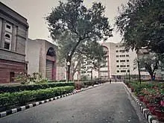
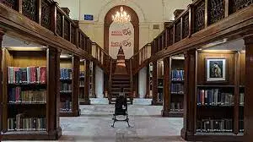
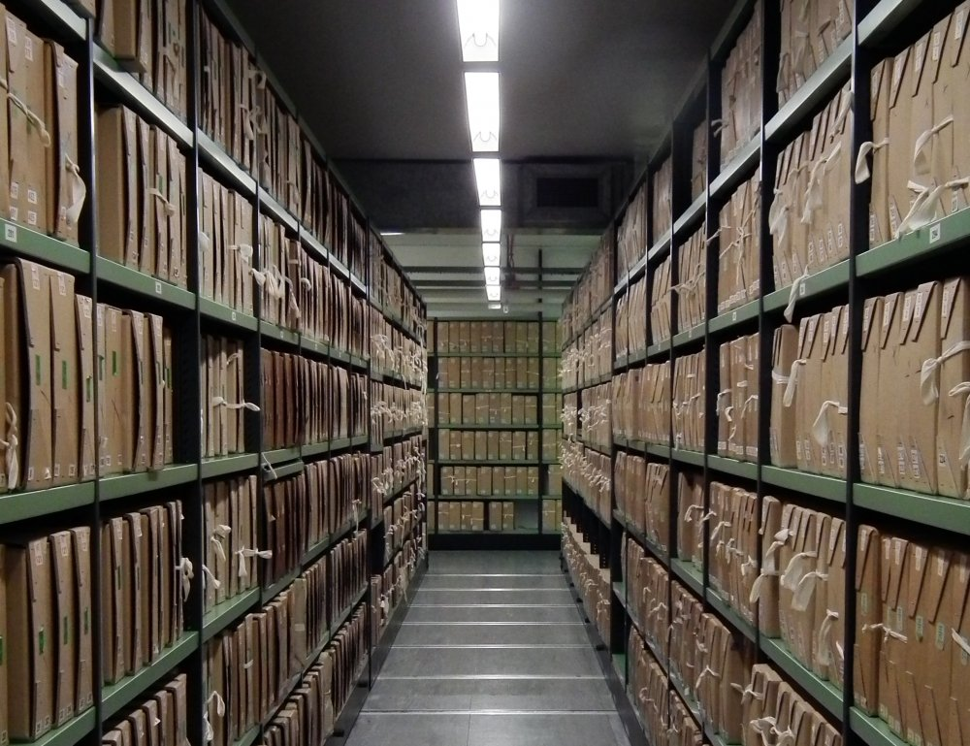
National Archives

Slide 21
E) Folklore
Folklore can be described as traditional art, literature, knowledge, and practices that are passed on in large part through oral communication and example.
The information thus transmitted expresses the shared ideas and values of a particular group.
British antiquarian William Thoms is generally credited with coining the term "folklore" in 1846.
Elliott Oring states that folklore is that part of culture that "lives happily ever after".
The academic study of folklore is most often known as folkloristics, although it is sometimes also termed "folklore studies" and "folk life research".
As an academic discipline folklore shares methods, and insights with literature, anthropology, art, music, history, linguistics, philosophy, and mythology.

Slide 22
F) Literature
Literature consists of written productions, often restricted to those deemed to have artistic or intellectual value.
Its Latin root literatura was used to refer to all written accounts
Literature often uses language differently than ordinary language (see literariness).
Literature can be classified according to whether it is fiction or non-fiction and whether it is poetry or prose
It can be further distinguished according to major forms such as the novel, short story or drama
And works are often categorized according to historical periods or their adherence to certain aesthetic features or expectations
The concept has changed meaning over time: nowadays it can broaden to include non-written verbal art forms, and thus it is difficult to agree on its origin

Slide 23
History was considered as a part of literature since history was reconstructed mainly on the basis of literary texts
Literature is the reflection of life
Literary texts are related to past , present and future
It provides ample information about history
But one has to be very cautious while using literary texts for reconstruction of history
Literature is used by a historian to enhance the beauty of their historical writings
Biographies and auto-biographies are often considered as both historical and literary works
A literary text may be produced around some happening or event which might not have altogether happened
Literary texts are used only as a secondary source for historical reconstruction

Slide 24
F) Toponymical
Oral tradition, in the form of stories, songs, and place names, was the primary method for the dissemination of knowledge and instruction, from generation to generation, in societies that did not rely on written language.
The identification of area place names known within the area you are attempting to focus on can often yield valuable information on any areas past use that might not otherwise be known.
While it is true that the nature of place names differ greatly depending on the culture assigning a name, all names can tell us much regarding the landform or place being named, the people doing the naming, and/or events tied to a general locale.
Place names often convey diverse information on a variety of traditional features of a people.
This information is especially important in an area where historical records are sparse or populations were decimated by disease and/or displaced through forced relocation.
The primary information conveyed in place names often deals with the occupation of the land and the delineation of band or language territory.
Names also describe resource use, population centres, trail systems, transportation routes, hunting strategies, food preservation techniques, beliefs, the general economy of an area, and
clues to the identity of previous inhabitants.

Slide 25
The meaning behind these names provides a glimpse of the ancient relationships with the land and the personal life experiences that perhaps have set one location off from another.
Fragments of history can be reconstructed by studying when the distribution of names reflects the sharing of a territory with members of other language groups or where the absence of names hints at band extinction.
Because place names tend to be consistent through time, their antiquity reflects the history and importance of particular locations.
Place names serve as a representation of an area's history, a focus of culture and knowledge which was/is important for the maintenance of the physical and spiritual identity of a people.
When a name is forgotten, more than a name is lost.

Slide 26
The study of place names is called as Toponymy
It studies the origins, meanings, use and typology of a place
Toponymy can uncover historical information about a place
The first toponymists were story tellers and poets
Toponymy provides geographical references

Slide 27
e- Sources
1, INFLIBNET
Information and Library Network(INFLIBNET) is an autonomous Inter-University Centre (IUC) of UGC
It is involved in creating infrastructure for sharing library and information resources and services among Academic and Research Institutions
INFLIBNET works collaboratively with Indian university libraries
This major programme was initiated by UGC in 1991 with its HQ at Gujarat University Campus at Ahmedabad
It became an independent Inter-University centre in 1996
N-list is the major utility service of INFLIBNET
It is aiming to provide instant access to a rich and diverse collection of electronic academic journals to its users
INFLIBNET is involved in modernising university libraries in India
It connects libraries as well as information centres in the country through a nation wide high speed data network

Slide 28
2,Shodhganga
A reservoir of Indian theses is a digital repository of theses and dissertations submitted to Indian universities.
It is maintained by INFLIBNET Centre which is an autonomous Inter-University Centre of the University Grants Commission (UGC) of India, was initially located in the campus of Gujarat University, Ahmedabad.
As of January 2013, INFLIBNET Centre has moved to its new institutional building at infocity, Gandhinagar capital of Gujarat.
As on 4 October 2016, as many as 293 universities in India have signed MoUs with the INFLIBNET Centre to participate in the Shodhganga project.
A further 13 centrally funded technical institutions have also signed MoUs with the Centre to participate in the Shodhganga project.
The full text of all the documents submitted to Shodhganga are available to read and to download in open access to the academic community worldwide.
The repository has a collection of 2,10,661 theses and 6123 synopses.
The top five universities in terms of the numbers of theses submitted are Punjab University, Aligarh Muslim University, Jawaharlal Nehru University, Karnataka University and Anna University.
The Shodhganga repository was created consequent on the University Grants Commission making it mandatory through regulations issued in June 2009 for all universities to submit soft copies of PhD theses and MPhil dissertations to the UGC for hosting in the INFLIBNET

Slide 29
3, www.cds.edu (CDS-Centre for Developmental Studies)
Set up in 1970 by the late famous economist Professor K.N. Raj
The Centre for Development Studies (CDS) is a self-governing institution known for its research in applied economics and topics germane to socio-economic development, pedagogy, and training programmes.
The CDS is housed in Prasanth Nagar in the Thiruvananthapuram city.
It is easily accessible by road, rail and air.
The 10 acre campus is designed and delivered by renowned architect and builder Padma Shri Laurie Baker.
The K. N. Raj Library at CDS is one of the biggest repositories of books in South India with over 1,70,000 titles in economics and related disciplines and subscribing to about 260 print and 2800 online professional journals.
It has a faculty strength of about 20.

Slide 30
The Organizational Structure
The core financial support to the Centre comes from the Government of Kerala and the Indian Council of Social Science Research.
Reserve Bank of India and the NITI Ayog (formerly Planning Commission of India) have instituted endowment units for research in selected areas at CDS.
The Union Ministry of Overseas Indian Affairs has established a migration unit at CDS to study issues relating to international migration from India.
The governance of CDS rests with the Governing Body consisting of academicians from across India.
The present chairman of the Governing Body is Shri. K. M. Chandrasekhar I.A.S.
The current director is Professor Sunil Mani.

Slide 31
Verification and Authenticity of Data
The data of historical sources is subject to two types of evaluation. These two types are: (i) external evaluation or external criticism and (ii) internal evaluation or internal criticism.
Let us now look at these in detail.
(1) External Criticism(Heuristics or Lower Criticism):
The technique of testing the degree of authenticity of document is called External Criticism or Heuristics or Lower Criticism.
The ‘External Criticism’ is of a Data Collection or Literature Review
This step involves identifying, locating, and collecting information pertaining to the research topic.
The information sources are often contained in documents such as diaries or newspapers, records, photographs, relics, and interviews with individuals who have had experience with or have knowledge of the research topic.
Interviews with individuals who have knowledge of the research topic are called oral histories.
The documents, records, oral histories, and other information sources can be primary or secondary sources.
The problem of authenticity of document arises more in case of manuscripts than the
printed documents because the printed document have already been authenticated by
the editor

Slide 32
Historian has to resort to a number of tests to determine the authenticity of a particular document in his proposed area of research such as— ‘Authorship’ the first question while examining the authenticity of a document is its author.
Even the anonymous writings can provide us useful and important knowledge.
But the discovery of an author’s or writer’s name adds the authenticity of the information because of the character, connections and trust worthiness of author determines the authenticity.
Secondly, “Date of Document”, i.e. the time, place of publication of the document must be inquired to determine the authenticity of the document.
In the modern publications year and place of publication is indicated on the book or document on the title page or back side (over leaf).
However in old manuscript where the data and place are absent it can be found out from the language or from the date of birth and death of author.
Thirdly, the historian confronts with the textual errors which may be either unintentional or deliberately committed.
Unintentional error can take place in the copies of the documents (originals are not available).
These mistakes may be caused by the scribe, typist or printer.

Slide 33
(2) Internal Criticism (Hermeneutics or Higher Criticism):
The Technique of testing the reliability of the contents of document is called Internal Criticism or Hermeneutics or Higher Criticism.
While collecting the material, it must be remembered that a document contains the idea of the man who wrote.
A historian must analyse the contents of the documents with a view to determine the real meaning.
He must try to avoid the laps such as avoid the reading into meaning which author did not mean to convey, etc., and make a sincere effort to find out the facts even if they are contrary to his set notions and theories.
He must be able to understand the literal and real meaning of the document which is termed as ‘Positive Criticism’.
It reveals us with the author’s conceptions and general notion which he represents.
On other hand, historian sometimes comes across documents which contradict each other.
Hence the need of eliminating statements and facts which are obviously wrong and false arises.

Slide 34
Generalizations
A generalization is a connection or relationship between facts
Acco Marc Bloch -It is an 'inference' or, 'an explanatory relationship between phenomena'.
It is the result of the effort to provide an explanation and causation, motivation and effect or impact.
It is the broad conclusion of a work
Historian uses generalisation to test his evidences
More widely, generalizations are the means through which historians understand their materials and try to provide their understanding of facts to others.
Analysis and interpretation of events, etc., is invariably done through generalizations.
Generalization leads to the production of a philosophy on the basis of known information
This is the means through which a historian understands their material

Slide 35
Thus, we make a generalization when we put our facts into a series one after another.
For example, when we mention the caste or religion of a leader we are making a generalization.
By connecting the caste and the leader or writer we are suggesting that his or her caste was an important part of his or her personality and, therefore, his or her political or literary work.
Or even the mention of his or her age.
More comprehensively, a generalization occurs when we try to understand facts, or make connection between data, objects, events, records of the past through concepts and convey them to others through concepts.

Slide 36
It enables a historian to analyse interpret and explain his data
It leads the historian to look for new facts and sources
It contains the essence of the whole essay
It leads to debates among historians

Slide 37
The roles played by generalization in History writing are:
(i) They serve as the organizing principles for his/her data thus resolving a basic problem for the historian with a mass of untidy facts in his notes not knowing how to put them in some type of order.
(ii) They improve a historian's perception or 'broaden his gaze'; they increase his ability to grasp an ever-increasing area of reality
(iii) They enable the historian to draw inferences and establish chains of causation and consequence or effect. In other words, they enable him to analyze, interpret and explain his data.
(iv) Generalizations lead the historian to look for new facts and sources. Quite often new sources can be properly grasped only through new generalizations.
(v) Generalizations also enable the historian to establish new connections between old, known facts.
(vi) Generalizations help the historian to avoid 'empiricism' or 'literalism' that is taking the sources at their face value or literal meaning

